Slide 1
THE QUESTION I PROMISED TO ANSWER
716 against 350.
2-bedroom 716 56%
3-bedroom 350 28%
4-bedroom 174 14%
5-bedroom 28 2%
1,268 units
Source: official unit mix, page 2. Classic 740 + Luxury 528 = 1,268.
Notes:
Two videos ago I asked you a question on camera. And I said I'd come back with the answer. Here it is.
I told you eighty-four percent of Thomson Reserve is two and three-bedders. And I asked you — which one takes the majority of that eighty-four?
The official unit mix is out. And it isn't close.
Seven hundred and sixteen two-bedroom units. Three hundred and fifty three-bedroom units. Out of one thousand two hundred and sixty-eight.
So inside that eighty-four percent — two out of every three units is a two-bedroom.
Today I'm going to take every single one of these layouts and put it next to what's actually selling around it. Same size. Layout against layout. Real transactions.
By the end you'll know which ones are worth your money and which ones you need to think twice about.

Slide 2
PART ONE, CORRECTED
I got something wrong.
I SAID Luxury 202 · Classic 1,066
IT IS Luxury 528 · Classic 740
202 and 1,066 are the 4+5 bed and 2+3 bed counts.
Right numbers. Wrong labels.
Source: official unit mix p02. Both collection tables print their own totals.
Notes:
First — I owe you a correction.
In Part One I said the Luxury Collection was two hundred and two units, and the Classic Collection was one thousand and sixty-six.
That was wrong.
Those two numbers are actually the four-and-five-bedroom count and the two-and-three-bedroom count. I put the right numbers against the wrong labels.
The real split is five hundred and twenty-eight Luxury. Seven hundred and forty Classic.
If you wrote my old numbers down — change them.

Slide 3
WHAT THIS VIDEO DOES
Four checks.
1 How efficient the layout actually is
2 What it really costs, like for like
3 Which block and stack you end up in
4 What that does to you the day you sell
MICRO CTA lands at the end of this slide.
Notes:
Four things today.
One — how efficient each layout actually is.
Two — what it really costs, compared like for like.
Three — which block and stack you end up in.
Four — what all of that does to you the day you sell.
And one promise before we start.
Every resale price I show you is a real transaction. Date, level, size, what was paid. You can pull every single one yourself.
Every Thomson Reserve price is an estimate, because the price list isn't out.
I'll tell you every time which one you're looking at.
MICRO CTA — Which one are you weighing up, the two-bedder or the three? Comment below. I read them.

Slide 4
RUN IT ON ANY FLOOR PLAN
The ninety-second test.
1 Take the strata area — the price-list number
2 Subtract what you can't live in — balcony,
planter, open terrace, aircon ledge
3 Look at the shape of what's left
BPS1 · 68 sqm · 67.6 labelled · balcony 7%
Source: TriForce deck p29, room areas printed on the plan by the developer.
Notes:
Here's the test. Ninety seconds on any floor plan.
Step one. Take the strata area. The number on the price list.
Step two. Find everything inside it you can't live in. Balcony. Planter box. Open terrace. Aircon ledge. Take it out.
Step three — and this is the one people miss. Look at the shape of what's left. A thousand square feet with a long corridor running through it is not a thousand square feet. It's nine hundred, and a hallway.
Now let me show you a good one.
Thomson Reserve has done something unusual. They've dimensioned every single room on the plan.
Two-bedroom premium plus study. Sixty-eight square metres.
Living and dining, twenty-three point five. Master, ten point nine. Second bedroom, eight point nine. Study, five point two. Master bath, five point one. Kitchen, four point nine. Balcony, four point eight. Second bath, three point nine. Store, zero point four.
Add it up. Sixty-seven point six out of sixty-eight.
Zero point four square metres unaccounted for. No dead corridor. Nothing left over.
And the balcony is seven percent. Seven percent of what you pay for is outdoors.
Hold that number. It's the one I keep coming back to.

Slide 5
THE ADJUSTMENT, EXPLAINED ONCE
Same money, different year.
Real transaction
+ 2% a year since that lease started
+ 5% for GFA harmonisation
= what it would cost brand new today
2018 lease → +21% 2021 lease → +15%
This is the method printed on every one of the comparison slides.
Notes:
One more thing, and it's the part almost everybody gets wrong.
When you compare a brand new launch against a resale up the road, the sticker prices are not comparable. Two reasons.
One — the lease. A JadeScape unit started its ninety-nine years in 2018. An AMO Residence unit started in 2021. Thomson Reserve starts from zero. Call that two percent a year.
Two — harmonisation. New launches measure floor area differently from these older projects. What counts and what doesn't has changed. Call that five percent.
So a 2018 lease — eight years at two percent, plus five. Twenty-one percent. A 2021 lease — fifteen percent.
What that gives me is: what would this resale cost if it were brand new, fresh lease, measured the way a new launch is measured.
That's the number you can hold against Thomson Reserve.
And I'll say it plainly — the two percent and the five percent are my assumptions. They're reasonable. They're not handed down from anywhere. I'll show you the raw transaction every time, so if you think it should be one percent, run it at one percent.

Slide 6
716 UNITS · 56% OF THE PROJECT
The two-bedroom.
592 sqft 2 bed 1 bath 100 units
678 sqft 2 bed 2 bath 416 units
732 sqft 2 bed + study 120 units
Notes:
Let's start where most of you are actually looking.
Seven hundred and sixteen units. Fifty-six percent of this project.
Three sizes. Five ninety-two. Six seventy-eight. And seven thirty-two with a study.

Slide 7
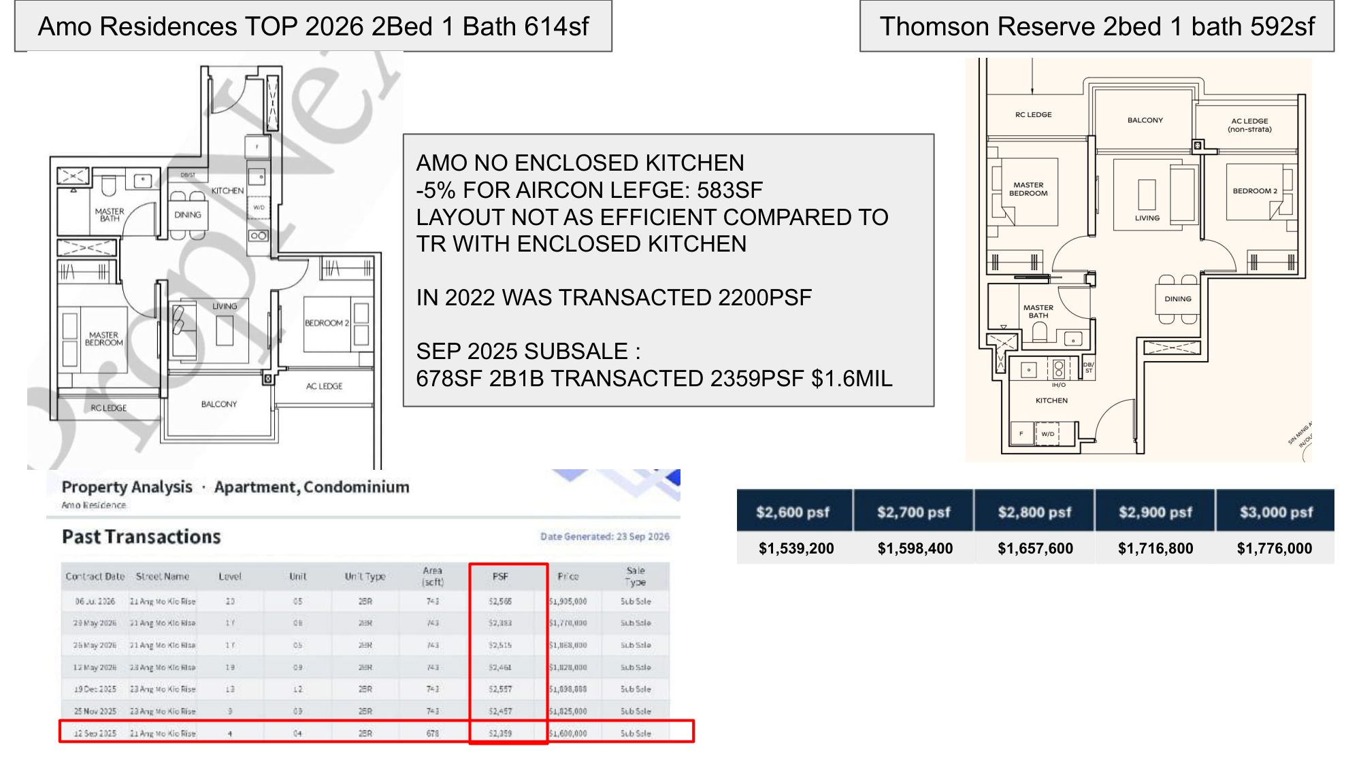
ON-SCREEN FIX NEEDED — transaction row is 678 sqft, not 614 — this slide is layout-only
Notes:
The smallest unit first. Two bedroom, one bath, five hundred and ninety-two square feet. A hundred of them.
Against AMO Residence. Two bedroom, one bath, six hundred and fourteen. Twenty-two square feet bigger.
Now run the test.
AMO's kitchen is open. It's not enclosed. Take five percent off for the aircon ledge and you're at five eighty-three.
So the six-fourteen that looked bigger is now nine square feet smaller than the Thomson Reserve unit. And you've lost an enclosed kitchen.
[NOTE TO SELF] The transaction shown on this slide is a 678 sqft unit, not a 614. Treat this slide as the LAYOUT comparison only. The price comparison lands on the next slide.

Slide 8
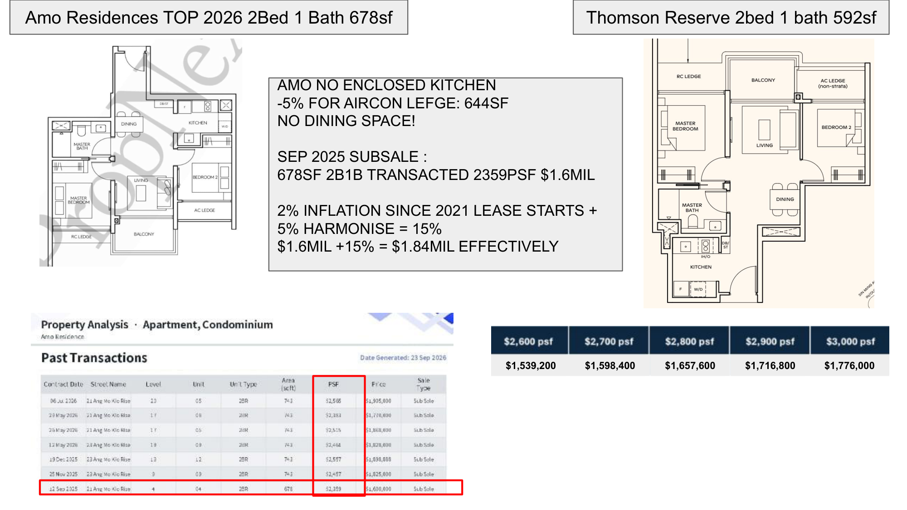
ON-SCREEN FIX NEEDED — "NO DINING SPACE!" — the plan is labelled DINING. Reword to "dining sits in the kitchen run"
Notes:
Same Thomson Reserve unit. Bigger AMO one — six hundred and seventy-eight.
Take the five percent off: six forty-four.
And look at this plan. There's no real dining space. The dining is squeezed into the kitchen run — it isn't a room, it's a gap between counters.
The transaction. September last year, twenty-one Ang Mo Kio Rise, level four. Six seventy-eight square feet, two thousand three hundred and fifty-nine a foot. One point six million.
AMO's lease started 2021. Fifteen percent.
One point six million becomes one point eight four million effective.
Thomson Reserve's five ninety-two at two thousand nine hundred a foot is one million seven hundred and sixteen thousand eight hundred.
A hundred and twenty-three thousand dollars less. Brand new. Fresh lease.
[SAY IT THIS WAY] Do NOT say "no dining space" — the developer has printed the word DINING on that plan. Say the dining sits in the kitchen run rather than having its own space.

Slide 9
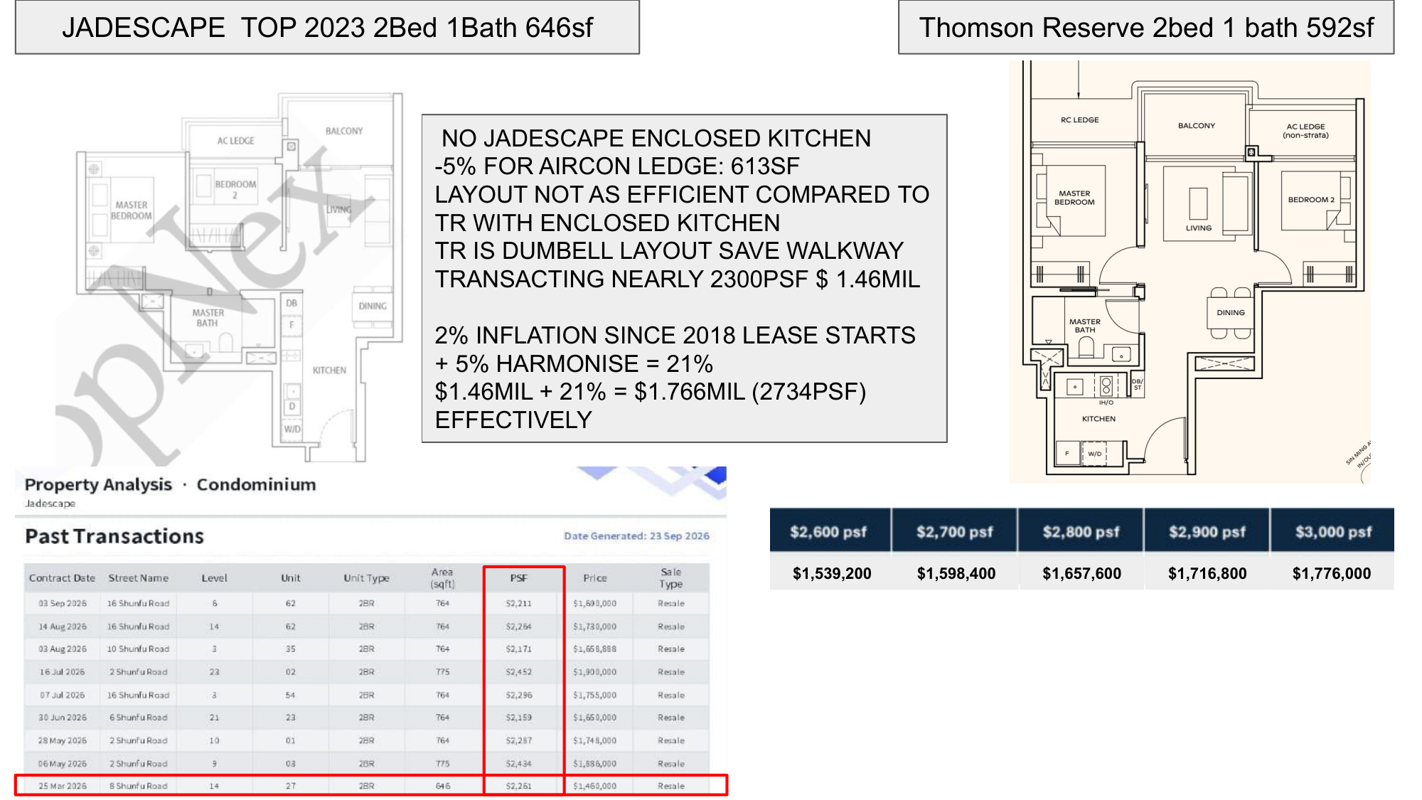
Notes:
Now JadeScape. Two bedroom, one bath, six hundred and forty-six square feet.
Same story — no enclosed kitchen. Minus five percent for the aircon ledge: six hundred and thirteen.
Twenty-one square feet apart. Not fifty-four.
And here's the structural difference. Thomson Reserve is a dumbbell layout. Bedrooms at both ends, living in the middle. No corridor at all.
The transaction. Twenty-fifth of March this year, eight Shunfu Road, level fourteen. Six forty-six square feet, two thousand two hundred and sixty-one a foot. One million four hundred and sixty thousand.
2018 lease. Twenty-one percent.
One point seven seven million effective. Two thousand seven hundred and thirty-five a square foot.
Thomson Reserve: one million seven hundred and sixteen thousand eight hundred.
Fifty thousand less, and you get the better layout.

Slide 10
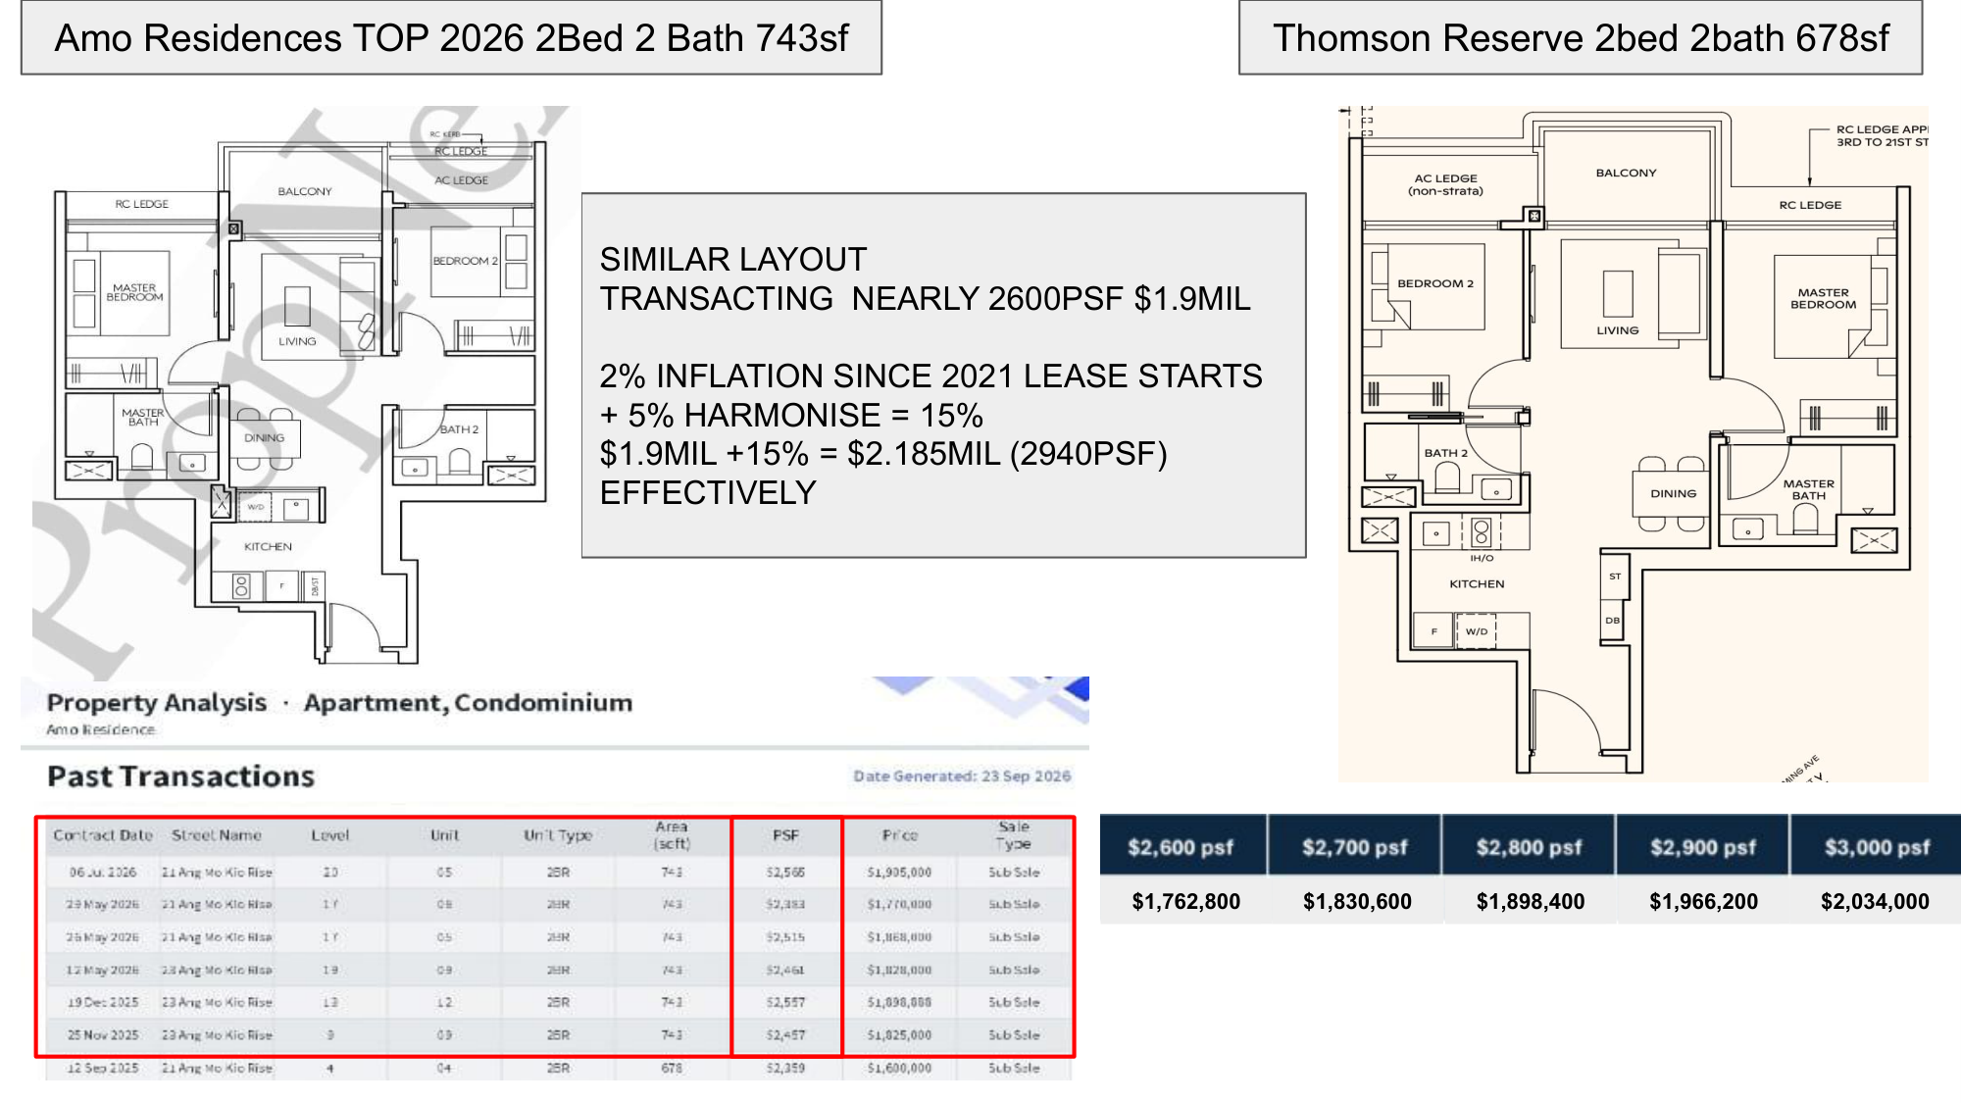
Notes:
Now the big one. Two bedroom, two bath, six hundred and seventy-eight square feet.
Four hundred and sixteen of these. More than any other unit in this project. A third of the whole development.
AMO's equivalent is seven hundred and forty-three. And I'll be fair — this is a similar layout. Genuinely comparable.
The transaction: sixth of July this year, twenty-one Ang Mo Kio Rise, level twenty. Seven forty-three square feet, two thousand five hundred and sixty-five a foot. One million nine hundred and five thousand.
And I'm using the strongest price AMO has achieved here — not the average. Because that's what a new launch has to beat.
Fifteen percent for the 2021 lease. Two point one nine million effective. Two thousand nine hundred and forty-nine a foot.
Thomson Reserve: one million nine hundred and sixty-six thousand two hundred.
Two hundred and twenty-four thousand less.

Slide 11
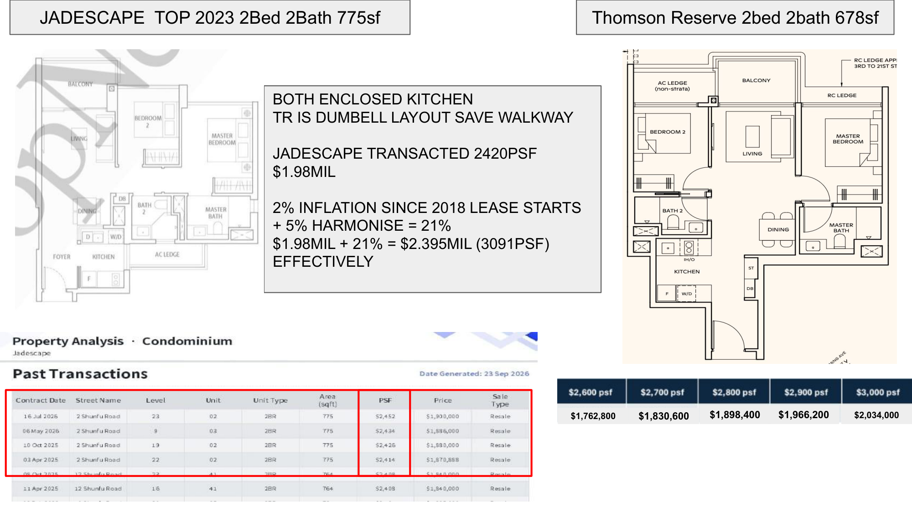
ON-SCREEN FIX NEEDED — $1.98MIL at 2420 psf — no such row. Use $1,900,000 at $2,452 → effective $2.299M / $2,966 psf
Notes:
Same Thomson Reserve unit. JadeScape's is seven hundred and seventy-five.
Both enclosed kitchens — so this is a fair fight on the kitchen. Thomson Reserve is still the dumbbell. Still no corridor.
The transaction: sixteenth of July this year, two Shunfu Road, level twenty-three. Seven seventy-five square feet, two thousand four hundred and fifty-two a foot. One million nine hundred thousand.
Twenty-one percent. Two point three million effective. Two thousand nine hundred and sixty-six a square foot.
Thomson Reserve: one million nine hundred and sixty-six thousand two hundred.
Three hundred and thirty thousand dollars of daylight. On the unit type that is a third of this project.
[SIGN-OFF NEEDED] The slide says $1.98M at 2420 psf. There is no $1.98M row in the table — the four highlighted 775 sqft rows are $1,900,000 / $1,886,000 / $1,880,000 / $1,870,888. And 2,420 x 775 = $1,875,500. The script above uses $1,900,000 at $2,452, the highest real row. Effective becomes $2.299M / $2,966 psf. The conclusion does not change.

Slide 12
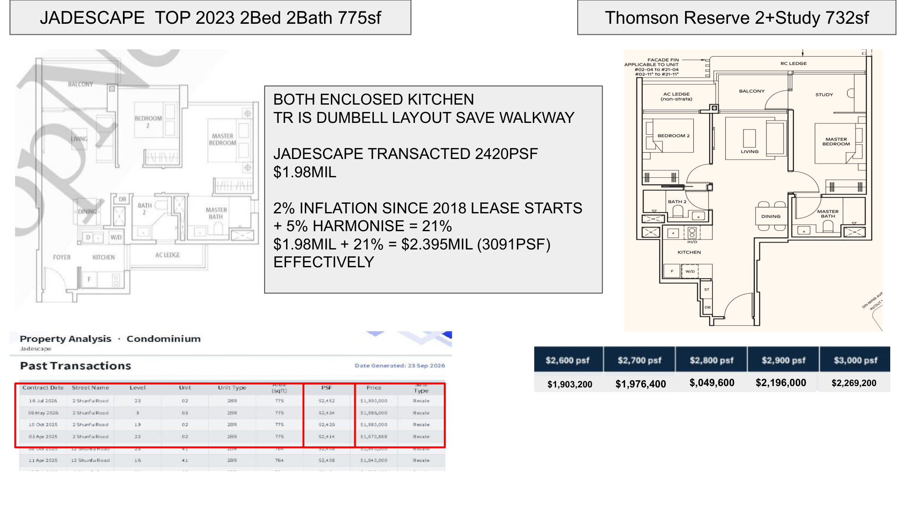
ON-SCREEN FIX NEEDED — price row: $,049,600 missing its 2 · last two columns shifted — $2,900 should read $2,122,800 and $3,000 should read $2,196,000 · $1.98MIL → $1,900,000 (same as previous slide)
Notes:
Now Thomson Reserve's two-bedroom premium plus study. Seven hundred and thirty-two square feet. A hundred and twenty of them.
Seven thirty-two against seven seventy-five. Forty-three square feet. That's a rounding error — for our purposes these are the same unit.
Except one of them has a study.
JadeScape effective: two point three million.
Thomson Reserve at two thousand nine hundred: two million one hundred and twenty-two thousand eight hundred.
A hundred and seventy-six thousand cheaper. And you get a study.

Slide 13
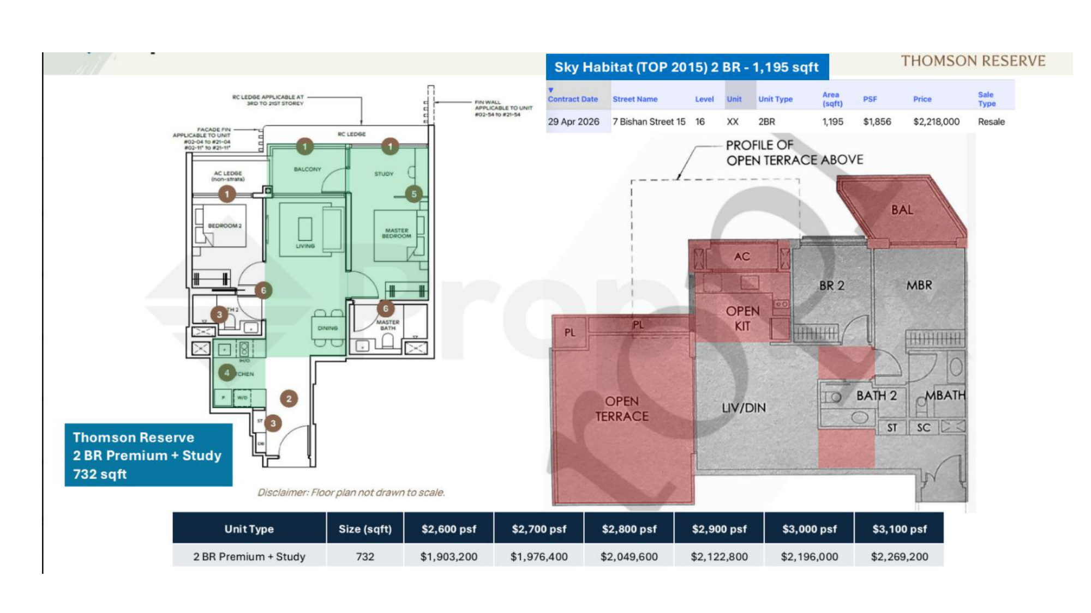
Notes:
Now the comparison people keep sending me. Sky Habitat, in Bishan.
Two bedroom. One thousand one hundred and ninety-five square feet.
Twenty-ninth of April this year, level sixteen. Two million two hundred and eighteen thousand. Eighteen fifty-six a foot.
Four hundred and sixty-three square feet bigger than the Thomson Reserve unit, and cheaper per foot.
So why isn't that just the better buy?
Look at the plan. Open terrace. Two planter boxes. Open kitchen. Balcony.
A serious share of that eleven ninety-five is space you cannot put a bed in, cannot air-condition, and cannot close a door on.
I'm not going to give you a percentage there, because I haven't measured it and I won't put a number on screen I can't stand behind. Look at the shaded plan and judge it yourself.
And let me be straight with you. At two point two million for eleven ninety-five square feet, two hundred metres from Bishan MRT — Sky Habitat is a real option. It's a 2015 building, it sits outside the six projects I benchmark against, and it is not a like-for-like.
But if raw space is what you're buying, it's on the table. I'd rather tell you that than pretend it isn't.
[DO NOT] state a liveable-area percentage for Sky Habitat. It has not been measured and the deck's shading is not a measurement.

Slide 14
350 UNITS · 28% OF THE PROJECT
The three-bedroom.
947 sqft 3 bed 120 units
1,055 sqft 3 bed premium 170 units
1,152 sqft 3 bed + study 60 units
Notes:
Three hundred and fifty three-bedders. Twenty-eight percent.
Nine forty-seven. One thousand and fifty-five. And eleven fifty-two with a study.
This is where the layout quality actually starts to decide it.

Slide 15
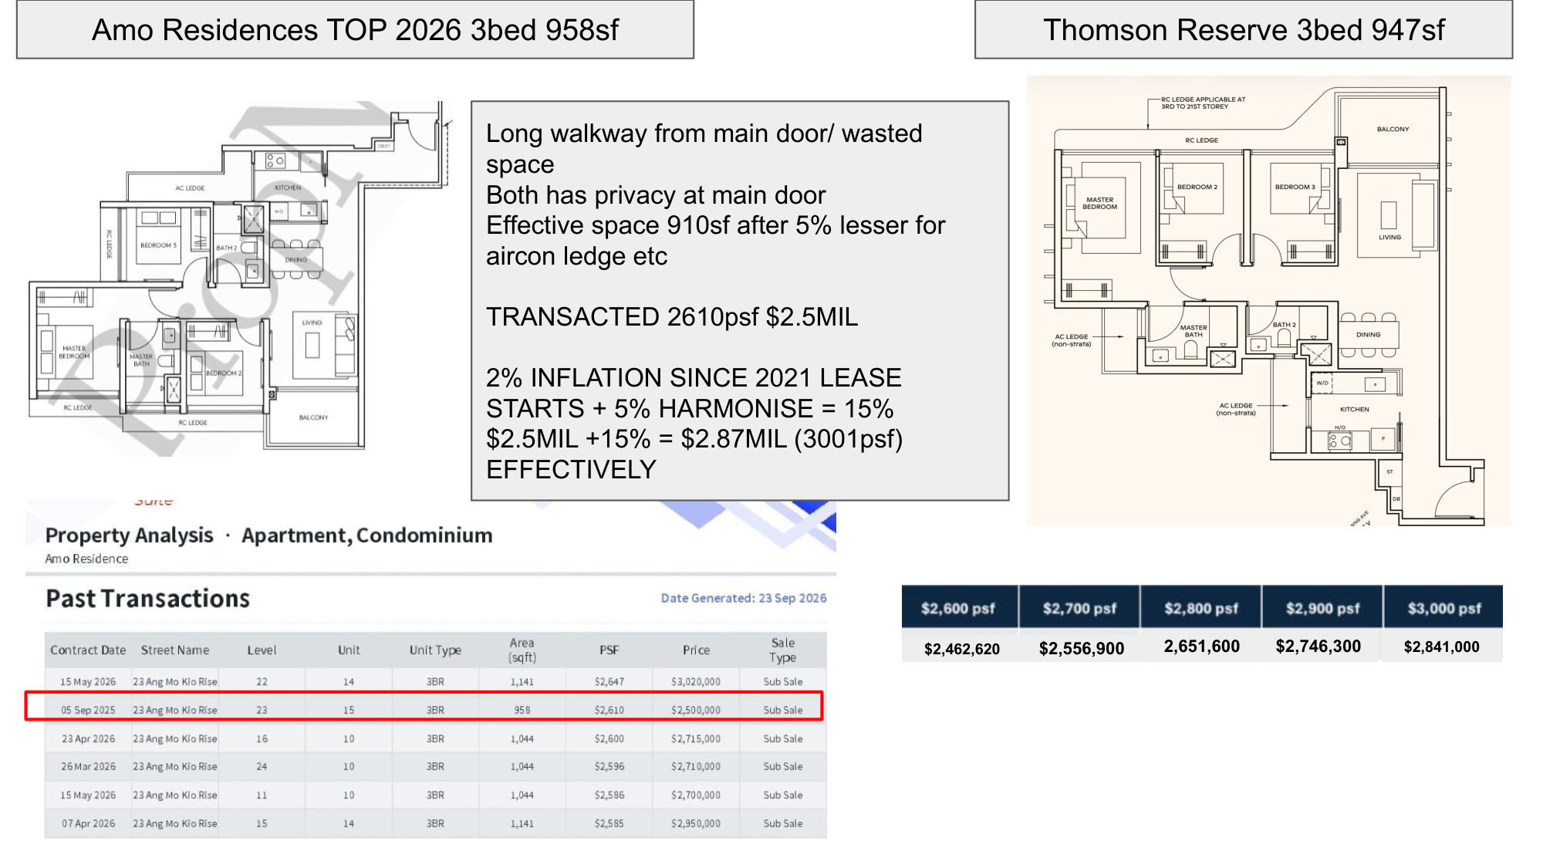
ON-SCREEN FIX NEEDED — $2,462,620 → $2,462,200 (947 x 2,600) · third cell missing its $ sign
Notes:
Nine hundred and forty-seven square feet. A hundred and twenty of them.
AMO's three-bedroom is nine fifty-eight. Eleven square feet bigger.
Take five percent for the aircon ledge — nine hundred and ten. Now it's thirty-seven square feet smaller than the Thomson Reserve unit.
And there's a long walkway from the main door on the AMO plan. Space you paid for and you walk through.
I'll give them one though — both plans give you privacy at the main door. That matters and AMO has it.
The transaction: fifth of September last year, level twenty-three. Nine fifty-eight square feet, two thousand six hundred and ten a foot. Two and a half million.
Fifteen percent. Two point eight seven five million effective. Three thousand and one a square foot.
Thomson Reserve: two million seven hundred and forty-six thousand three hundred.

Slide 16
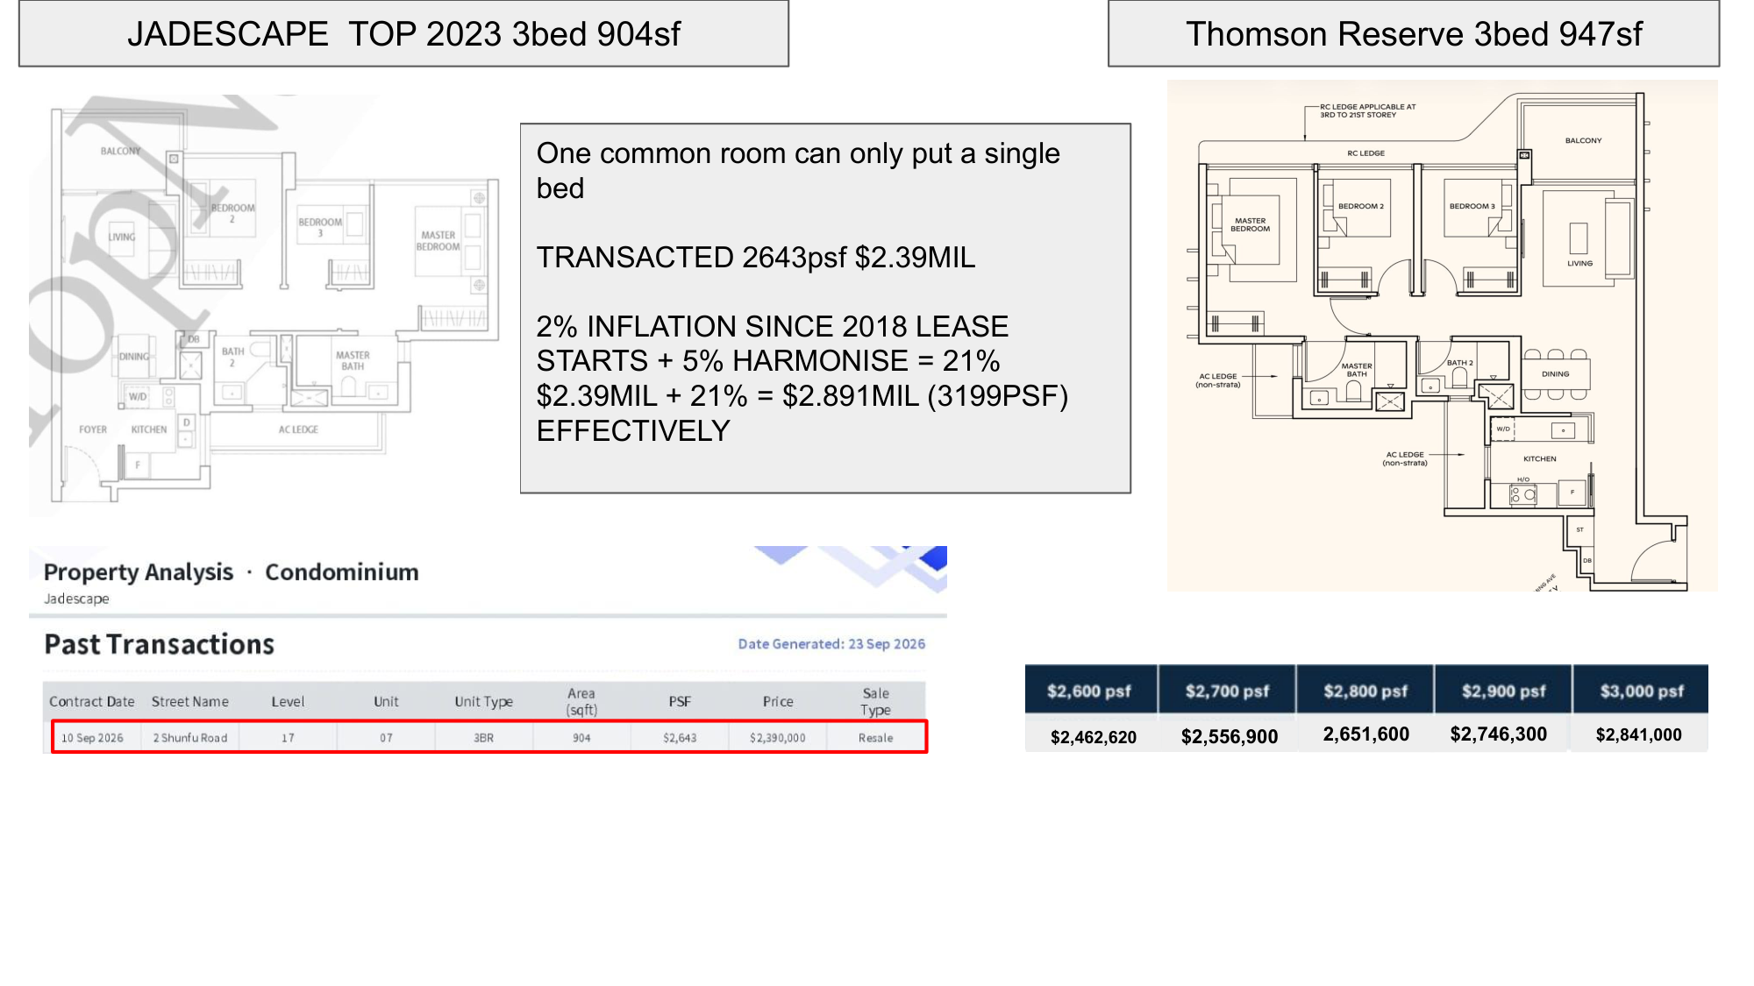
ON-SCREEN FIX NEEDED — $2,462,620 → $2,462,200 · third cell missing its $ sign
Notes:
JadeScape's three-bedroom is nine hundred and four square feet. Smaller than Thomson Reserve's before you adjust anything.
And here's the thing about it. One of the common bedrooms only takes a single bed. Not a queen. A single.
That is not a three-bedroom for a family of four. It's a two-bedroom with a study that they're calling a bedroom.
The transaction: tenth of September this year — that's two weeks ago — two Shunfu Road, level seventeen. Nine hundred and four square feet, two thousand six hundred and forty-three a foot. Two point three nine million.
Twenty-one percent. Two point eight nine million effective. Three thousand one hundred and ninety-nine a square foot.
Thomson Reserve: two million seven hundred and forty-six thousand three hundred.
Cheaper than both. Bigger than both once you strip the ledges. And you can put a queen in every room.

Slide 17
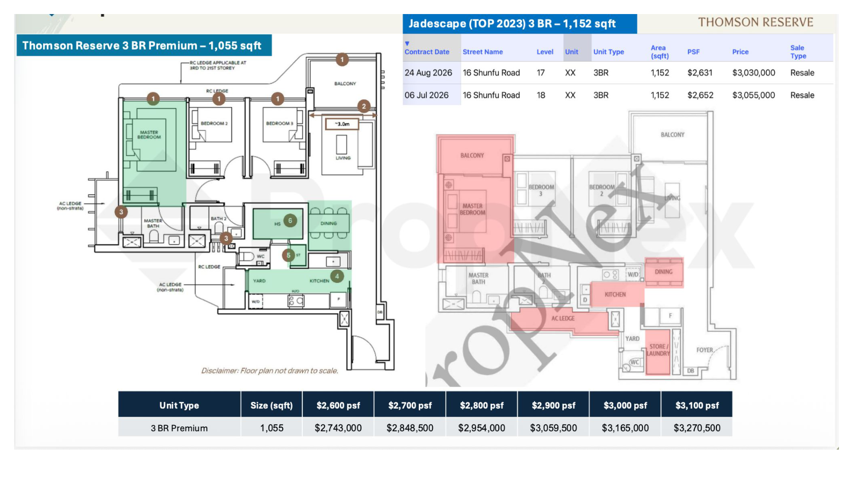
Notes:
This is Thomson Reserve's three-bedroom premium. One thousand and fifty-five square feet. A hundred and seventy of them — the third biggest type in the project.
JadeScape's three-bedder is eleven fifty-two. Ninety-seven square feet bigger, so I'm going to compare these per square foot, not total price — the sizes aren't matched.
Two transactions on this one. Twenty-fourth of August, level seventeen, three million and thirty thousand. Sixth of July, level eighteen, three million and fifty-five thousand.
Adjusted, JadeScape comes out around three thousand one hundred and eighty a square foot.
Thomson Reserve's indicative band is twenty-six to thirty-one hundred.
And look at the layouts side by side. The JadeScape master has the balcony wrapping it. The dining sits off on its own away from the living. The kitchen is a through-route.
Thomson Reserve: three metre living frontage, dining sitting with the living, kitchen and yard together at the back with the household shelter doing real work.
That's the difference between a plan drawn to hit a square footage and a plan drawn to be lived in.

Slide 18
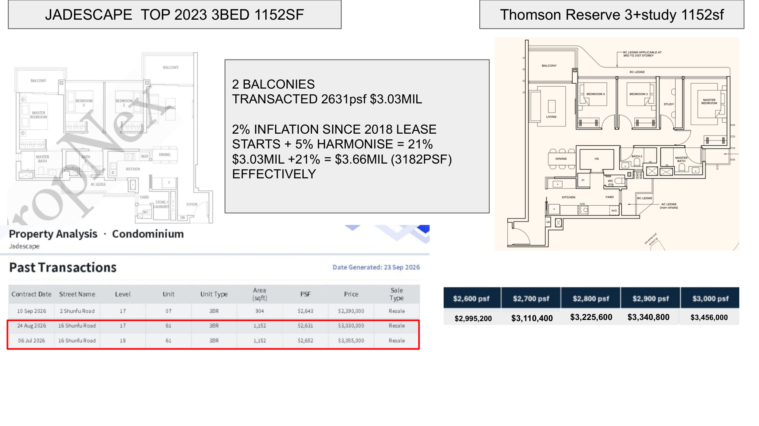
Notes:
Now the one I actually want you to remember. Because this is the only comparison in the whole video where I don't have to adjust for size at all.
Thomson Reserve's three-bedroom premium plus study. One thousand one hundred and fifty-two square feet. Sixty units.
JadeScape's three-bedroom. One thousand one hundred and fifty-two square feet.
Identical. Same number. Nothing to argue about.
The JadeScape one has two balconies. Twenty-fourth of August this year, sixteen Shunfu Road, level seventeen. Three million and thirty thousand. Two thousand six hundred and thirty-one a foot.
Now — here's where most agents would stop. So let me not.
If you buy the Thomson Reserve unit at two thousand nine hundred a foot, you are writing a cheque for three million three hundred and forty thousand eight hundred.
The JadeScape one sold for three million and thirty thousand.
You are paying three hundred and ten thousand dollars more. Today. Out of your actual account.
That is true, and nobody should hide it from you.
Now run the adjustment. 2018 lease. Twenty-one percent.
Three point zero three million becomes three point six six million. Three thousand one hundred and eighty-two a square foot.
Against Thomson Reserve at two thousand nine hundred.
Three hundred and twenty-five thousand — the other way.
Both of those numbers are real. Which one matters depends on one thing: how long you're holding.
Flipping in three years? The cheque is what matters, and JadeScape is cheaper.
Holding fifteen years? The lease and the floor plate are what matter, and the gap closes and then reverses.
Anyone who shows you only the second number is selling you something. Anyone who shows you only the first one doesn't understand what you're buying.

Slide 19
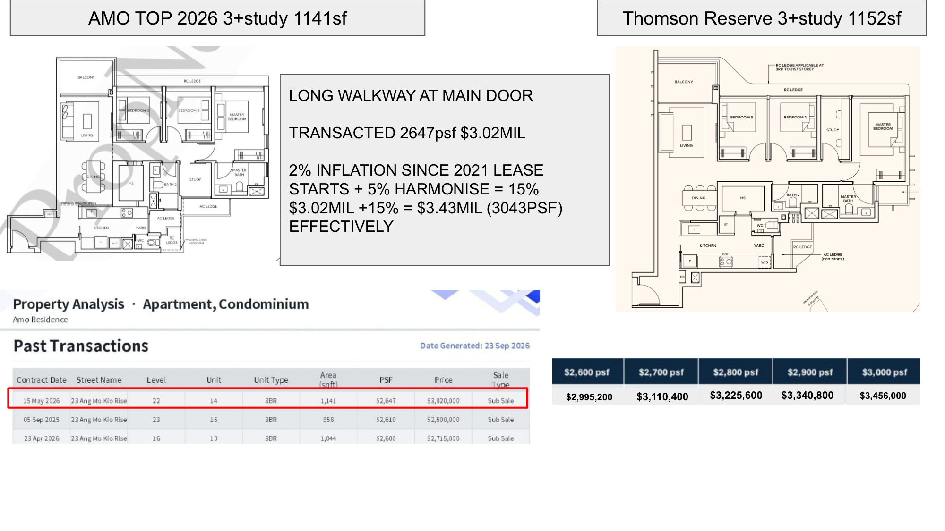
ON-SCREEN FIX NEEDED — $3.43MIL → $3.47MIL ($3.02M x 1.15 = $3.473M; your own 3043 psf confirms it)
Notes:
Same Thomson Reserve unit. AMO's three plus study is eleven forty-one. Eleven square feet apart — matched.
Long walkway at the main door again. Same problem as their three-bedder.
The transaction: fifteenth of May this year, level twenty-two. Eleven forty-one square feet, two thousand six hundred and forty-seven a foot. Three point zero two million.
Fifteen percent. Three point four seven million effective. Three thousand and forty-four a square foot.
Thomson Reserve: three million three hundred and forty thousand eight hundred.
A hundred and thirty-two thousand less.
[SIGN-OFF NEEDED] The slide prints $3.43MIL. $3.02M x 1.15 = $3.473M. The 3043 psf printed next to it is correct and is derived from $3.47M — so it is the millions figure that is mistyped, not the method.

Slide 20
4 AND 5 BEDROOM · 202 UNITS · 16%
The scarce end.
1,238 sqft 4 bed 90 units
1,367 sqft 4 bed premium, lift 56 units
1,485 sqft 4 bed + study, lift 28 units
1,808 sqft 5 bed suite, lift 28 units
Notes:
Now the scarce end.
A hundred and seventy-four four-bedders in the entire project. Eighty-four of those have a private lift.
And twenty-eight five-bedroom suites. Twenty-eight, out of one thousand two hundred and sixty-eight.
Different conversation, different buyer. But the same test.

Slide 21
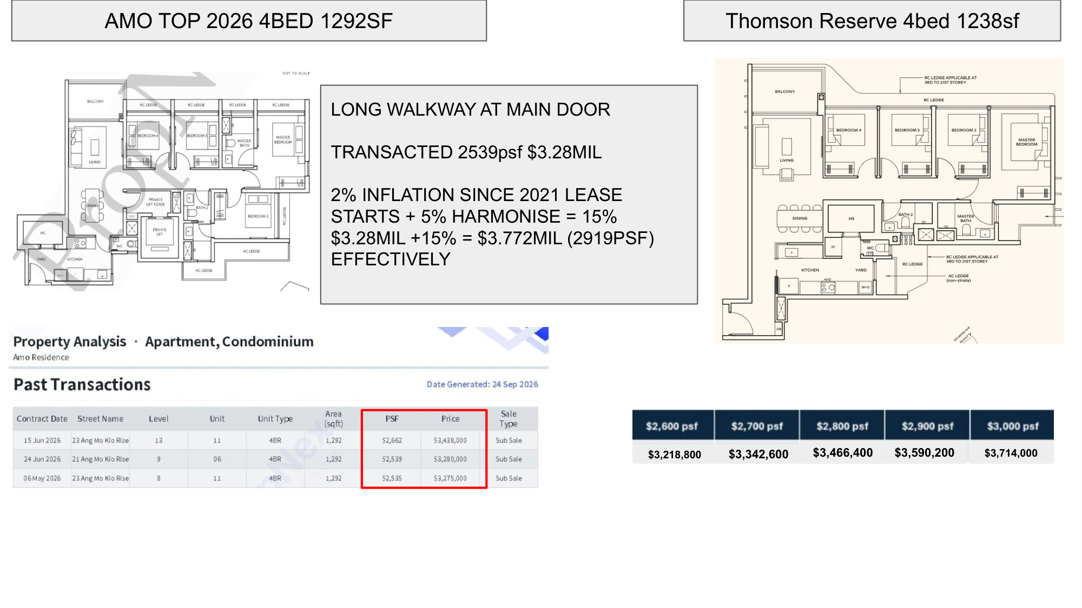
Notes:
Thomson Reserve's four-bedroom. Twelve hundred and thirty-eight square feet. Ninety of them.
AMO's is twelve ninety-two. Fifty-four square feet bigger. Long walkway at the main door — again.
The transaction: twenty-fourth of June this year, twenty-one Ang Mo Kio Rise, level nine. Twelve ninety-two square feet, two thousand five hundred and thirty-nine a foot. Three point two eight million.
Fifteen percent. Three point seven seven million effective. Two thousand nine hundred and nineteen a square foot.
Thomson Reserve: three million five hundred and ninety thousand two hundred.
A hundred and eighty-one thousand less.
[CHECK] On the two-bed slides you used each project's HIGHEST achieved psf. Here you've used the middle of three rows. The highest is $2,662 / $3,438,000 on 15 Jun 2026, which adjusts to $3.95M / $3,060 psf and widens the gap to $363,500. Either is defensible — pick one rule and say it out loud.

Slide 22
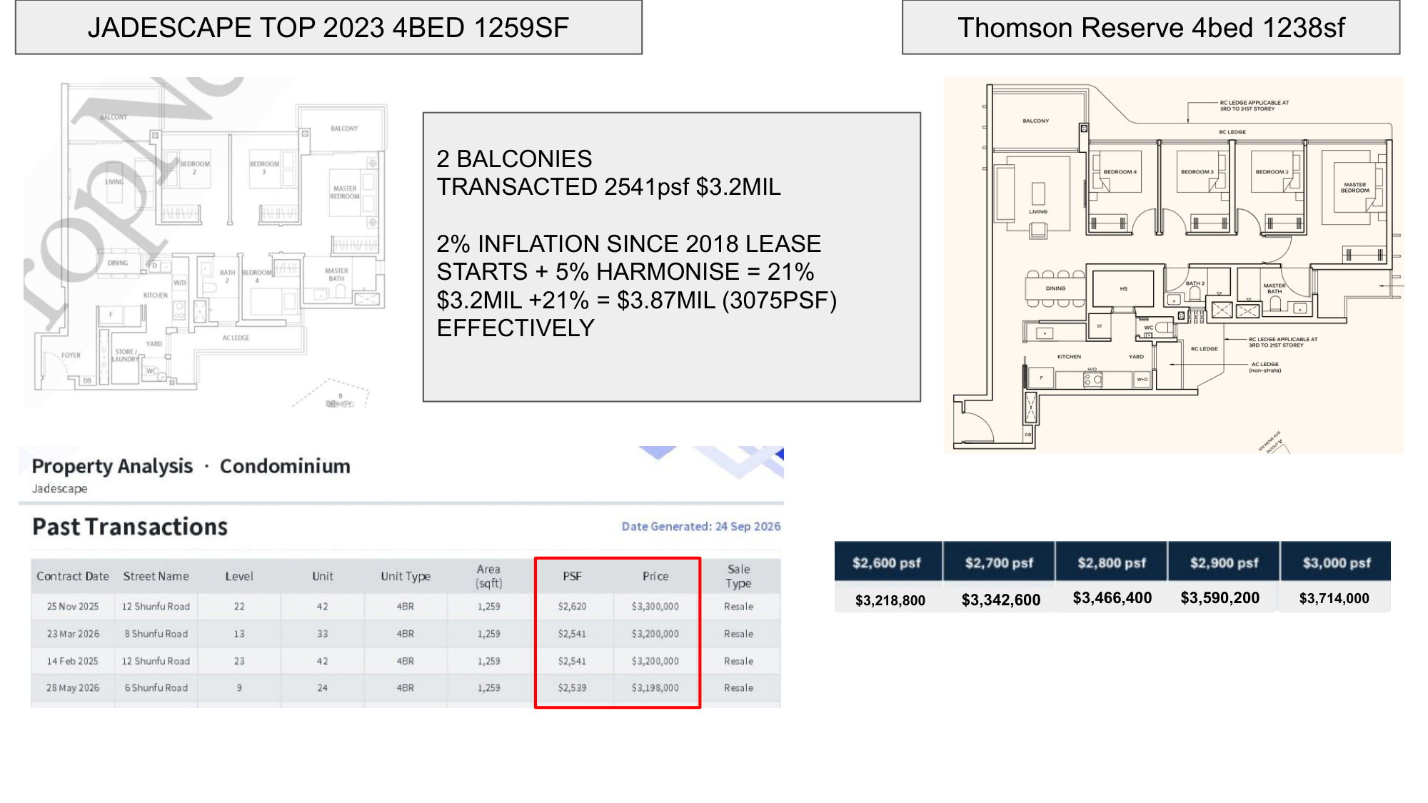
Notes:
JadeScape's four-bedroom. Twelve fifty-nine. Twenty-one square feet apart — this one's matched.
Two balconies again.
The transaction: twenty-third of March this year, eight Shunfu Road, level thirteen. Twelve fifty-nine square feet, two thousand five hundred and forty-one a foot. Three point two million.
Twenty-one percent. Three point eight seven million effective. Three thousand and seventy-five a square foot.
Thomson Reserve: three million five hundred and ninety thousand two hundred.
Two hundred and eighty-one thousand less.
[CHECK] Same point as the last slide — JadeScape's highest here is $2,620 / $3,300,000 on 25 Nov 2025, which adjusts to $3.99M / $3,172 psf.

Slide 23
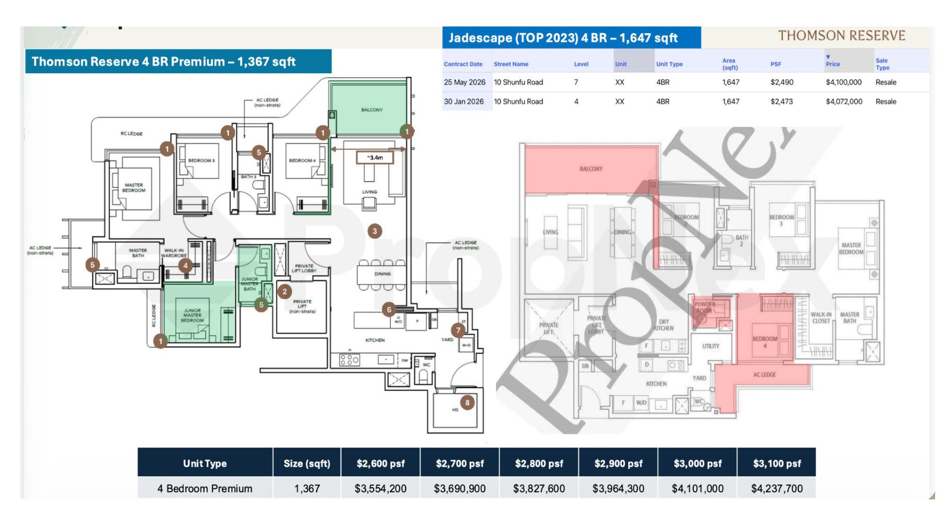
Notes:
Thomson Reserve's four-bedroom premium, with the private lift. One thousand three hundred and sixty-seven square feet. Fifty-six of them.
JadeScape's four-bedder here is sixteen forty-seven — two hundred and eighty square feet bigger, so again, this one is per square foot, not total.
Twenty-fifth of May this year, level seven. Four million one hundred thousand. Two thousand four hundred and ninety a foot.
Adjusted, that's about three thousand and twelve a square foot.
And one thing I want to be honest about, because it cuts against me. The JadeScape four-bedder also has a private lift. Look at the plan — private lift, private lift lobby. So the lift is not the Thomson Reserve advantage here. The lease and the floor plate are.

Slide 24
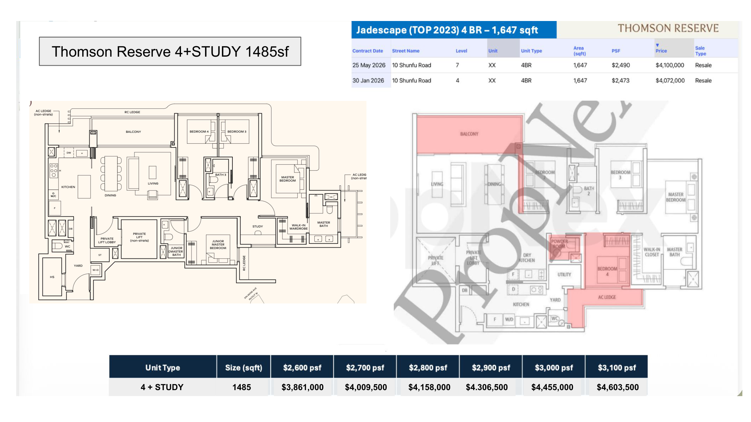
ON-SCREEN FIX NEEDED — $4.306,500 → $4,306,500 (full stop where the comma should be; the value is right)
Notes:
Four-bedroom premium plus study. Fourteen eighty-five. Twenty-eight units in the whole project.
Against the same JadeScape sixteen forty-seven. A hundred and sixty-two square feet apart.
Adjusted, JadeScape is around three thousand and twelve a foot. Thomson Reserve at two thousand nine hundred is four million three hundred and six thousand five hundred.
Twenty-eight units. That's the number to sit with.

Slide 25
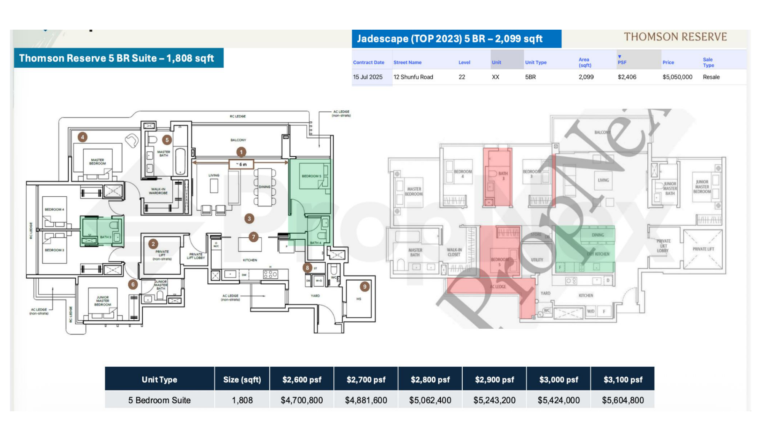
Notes:
And the top of the building. Five-bedroom suite, private lift. One thousand eight hundred and eight square feet. Twenty-eight units.
JadeScape's five-bedder is two thousand and ninety-nine. Nearly three hundred square feet bigger.
Fifteenth of July last year, twelve Shunfu Road, level twenty-two. Two thousand four hundred and six a foot. Five million and fifty thousand.
Adjusted, that's about two thousand nine hundred and eleven a foot.
Which lands almost exactly on Thomson Reserve's own band. At this size, the two projects price the same — and then it comes down to the lease, the floor plate, and which building you'd rather live in.

Slide 26
SIXTEEN COMPARISONS, EVERY ONE A REAL TRANSACTION
Two methods. One band.
MY READ $2,714 → $3,199 effective psf
16 pairings, 2 projects, +2%/yr +5% harmonisation
PROPNEX READ $2,864 → $3,077 effective psf
6 projects, lease pro-rated to 98 yrs, +7%
Different data. Different method. Same answer.
Sources: the 17 comparison slides; TriForce deck p07 for the PropNex band.
Notes:
Step back.
Sixteen comparisons. Two projects. Every single one a real transaction.
Here is every effective price per square foot I just worked out.
Twenty-seven fourteen. Twenty-seven thirty-five. Twenty-nine nineteen. Twenty-nine forty-nine. Twenty-nine sixty-six. Three thousand and one. Three thousand and twelve. Thirty forty-four. Thirty seventy-five. Thirty eighty-two. Thirty-one ninety-nine.
Every one of them between twenty-seven hundred and thirty-two hundred.
Now the part I find genuinely interesting.
PropNex ran a completely different calculation. Six projects, not two. Pro-rating the lease back to ninety-eight years instead of adding two percent a year. Seven percent for harmonisation instead of my five. Different data. Different method. Different people.
They landed on twenty-eight sixty-four to thirty seventy-seven.
Two methods that share almost nothing, landing in the same band.
That's not me being clever. That's the market telling you where this thing has to price.
So — if Thomson Reserve opens at twenty-six, twenty-seven hundred, that's under both reads, and you move.
If it opens at thirty-two, thirty-three hundred, that's above both, and you need a very specific reason.

Slide 27
THE MAP HAS TWO KINDS OF NUMBER ON IT
Which block are you in?
BLOCK TO BLOCK 240m 190m 182m 171m … 26m
BLOCK TO BOUNDARY 40m 37m 28m 19m … 10m
The 240 / 190 / 182 all start at BLOCK 7.
The 171 starts at BLOCK 5. Those are the private-lift blocks.
Every 2- and 3-bed type sits in BLOCK 1, 3, 9 or 11.
Source: TriForce p13 cross-referenced against the official floor plans. Every arrow identified in STACK_FACING.md.
Notes:
Everything so far has been about the layout. Now the part that decides whether you enjoy living there — and almost nobody checks it before selection day.
This is the developer's own block-to-block distance map.
Two hundred and forty metres. One hundred and ninety. One hundred and eighty-two. One hundred and seventy-one.
Then: ninety-five. Eighty. Seventy-seven. Sixty-three. Twenty-six.
First thing, and read this carefully, because the map doesn't tell you. Some of those numbers are block to block. Some are block to the edge of the site. They are printed identically and they mean completely different things.
If an agent quotes you a distance — ask which one it is.
Now here's what I want you to see.
The two forty, the one ninety, the one eighty-two — every one of those starts at Block Seven. The one seventy-one starts at Block Five.
Blocks Five and Seven are the private lift blocks. Four-bedroom premium. Five-bedroom suite. They also run to the thirtieth storey.
Every two and three-bedroom type in this project sits in Block One, Block Three, Block Nine or Block Eleven. All of them stop at the twenty-first storey. And the distances in that cluster run from ninety-five metres down to twenty-six.
So when I say don't blindly buy any layout — this is what I mean. The layout is identical across stacks. The view is not. And the long water frontages are attached to the units that cost two and a half times as much.
Two blocks to know.
Block One. On its own at the Bright Hill Drive end. Stacks one to nine. It carries one of every single type I've shown you today — and it has no other block facing it. None. Its only distances on this map are to the boundary.
If you want a two or three-bedder here, that's the block. The trade is it's the furthest walk to the main pool.
Block Three. Stacks ten to eighteen, right in the middle. Two hundred and forty metres of open water on one side. Twenty-six metres to Block Nine on the other.
Same block. Same price list. Same layout.
That's the whole video in one block. Which stack they put you in matters more than which layout you picked.
So on selection day — ask for the block and the stack, in writing. Ask whether the distance you're quoted is to another block or to the boundary. And ask what's going up on the other side of that boundary, because a setback that's generous today can close.
[DO NOT] put a compass facing on screen or say one aloud. Stack-by-stack facing has not been released. And do not say a named type sits on the 26m or the 10m — none of them do.

Slide 28
THE DAY YOU SELL
716 against 60.
2-bedroom 678 sqft 416 units
2-bedroom, all sizes 716 units
3-bedroom + study 1,152 60 units
Liquidity, or scarcity. Both are fine answers.
Notes:
Last one. And it's the one that separates a home from an investment.
Seven hundred and sixteen two-bedroom units. The day you sell, that's how many units inside your own development can be your competition. Same building. Same finishes. Same facing bands.
Now the three-bedroom premium plus study — the eleven fifty-two, the one I told you to remember.
Sixty units.
Sixty.
I'm not telling you the two-bedroom is a bad buy. Seven hundred and sixteen units also means it is the most liquid thing in this project. There is always a buyer at the right price. If there's any chance you need to move quickly, that's a real feature and you should value it.
What I'm telling you is — know which game you're playing.
Buy the two-bedder, you're buying liquidity. You'll compete on price. Plan for it.
Buy the eleven fifty-two, you're buying scarcity. Sixty units, and it's the one that stands up best against everything around it. But you need holding power, because scarcity takes time to pay.
Both are fine answers.
Picking one by accident is not.

Slide 29
BEFORE YOU GO
What I don't know.
The price list is not out — every TR number is an estimate
Stack-by-stack facing is not out — blocks only, no compass
The 2% a year and the 5% are my assumptions
The unit mix is the one thing that is official and confirmed
Full screen, no graphics. Straight to camera if you have the take.
Notes:
Before I let you go — what I don't know.
The price list is not out. Every Thomson Reserve number in this video is an estimate built from what the neighbours actually sell for.
The stack-by-stack facing is not out. I've shown you blocks and distances off the developer's own map. I have not told you which way anything points, because I don't know yet.
The two percent a year and the five percent for harmonisation are my assumptions. Reasonable ones. Still assumptions.
The unit mix is the one thing here that is official and confirmed.
When the real price list drops, I'll come back and mark my own homework — the same way I corrected Part One at the top of this video.

Slide 30
THE CLOSE
Don't buy a square footage.
Buy a liveable square footage,
in a block you have actually checked,
at a number you set before you walked in.
MACRO CTA. QR code to be dropped in before export.
Notes:
So.
Don't buy a square footage. Buy a liveable square footage, in a block you have actually checked, at a number you set before you walked into the gallery.
And if the answer turns out to be that something else suits you better — good. That's the job.
If you want this run properly on your numbers — your budget, your shortlist, the stacks that suit how you actually live, and a backup vetted before selection day — the link's below. Or scan the code.
MACRO CTA — QR plus WhatsApp prefill: "Hi Coach Edmund, I'd like a Second Property Strategy Session (Thomson Reserve)."

